Slide 1
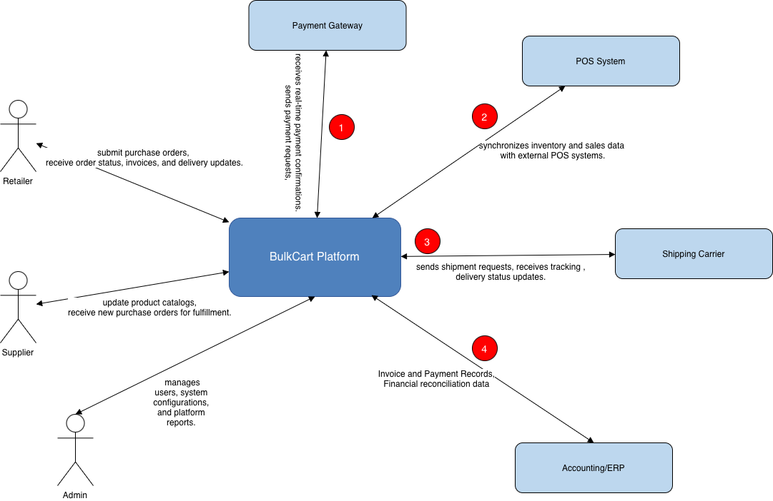
Team 1 – BulkCart
Context Diagram

Slide 2
System Interface Table
No | Description | Source | Target | Frequency | Validation
1a | Supports online payment processing | BulkCart | Payment Gateway | Real-time | Transaction amount validation; Payment authorization
1b | Provides payment confirmation data | Payment Gateway | BulkCart | Real-time | Transaction ID verification; Payment status validation
2a | Sends shipment requests and delivery details | BulkCart | Shipping Carrier | Event-based | Address validation; Shipment data completeness
2b | Provides tracking and delivery updates | Shipping Carrier | BulkCart | Event-based | Tracking number validation; Delivery status accuracy
3a | Sends product and pricing updates | BulkCart | POS System | Scheduled | SKU synchronization; Pricing accuracy
3b | Provides sales and inventory data | POS System | BulkCart | Scheduled | Inventory level validation; Sales data integrity
4a | Sends invoice and payment records for financial reporting | BulkCart | Accounting | Scheduled | Invoice total Validation; Supplier account mapping; Financial record Consistency
4b | Provides reconciliation and accounting status updates | Accounting | BulkCart | Scheduled | Reconciliation status verification; Payment posting accuracy

